Slide 1
ENGR 116 – 20c Lab Notebook
Geometric Modeling for Visual.
Fall 2016
Olivia Koehler

Slide 2
Table of Contents
8-23: Pg. 3
8-30: Pg. 9
9-6: Pg. 15
9-13: Pg. 19
9-20: Pg. 30
9-27: Pg. 37
10-4: Pg. 44
10-11: Pg. 53
10-18: Pg. 56
10-25: Pg. 61
11-1: Pg. 65
11-8: Pg. 69
11-15: Pg. 72
11-22: Pg. 76
11-29: Pg. 77
12-6: Pg. 80
12-13: Pg.

Slide 3
8-23: First Day of Class

Slide 4
8-23
What we did:
Went over how to use black board
Ran through the syllabus
Talked about class expectations
Sent contact info via Text Message (NotePad) to class
Explored SolidWorks

Slide 5
Work
Created a “Dynamic Cantilever Kit” Box with the measurements:
X = 24.5”
Y = 9”
Z = 4”
Cut a 1” hole through the center of the right side of the box

Slide 6
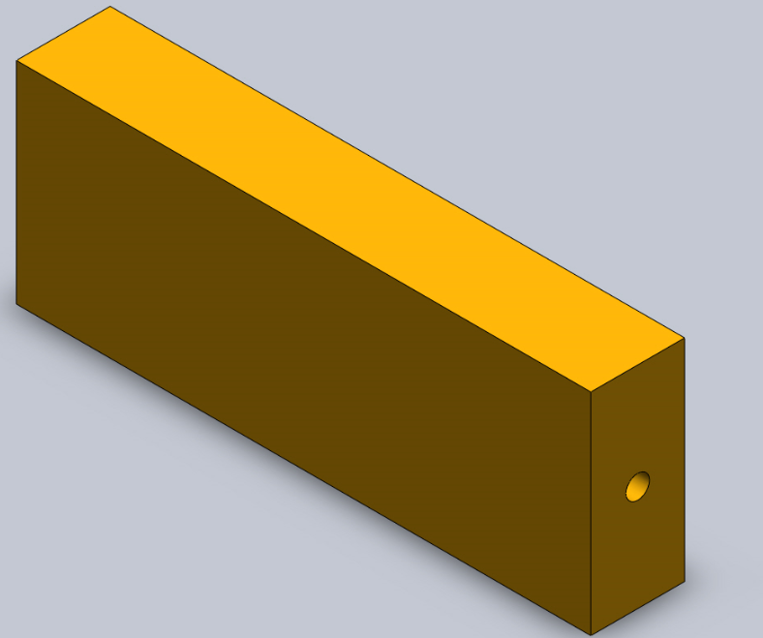
Work
Part 1

Slide 7
Work
Follow the directions given in the video supplied by ivytechengineering.com
Create the first part: Tutor 1
Submit Part to Professor
Video Link: https://www.youtube.com/watch?v=dQMS8KuDGoM

Slide 8
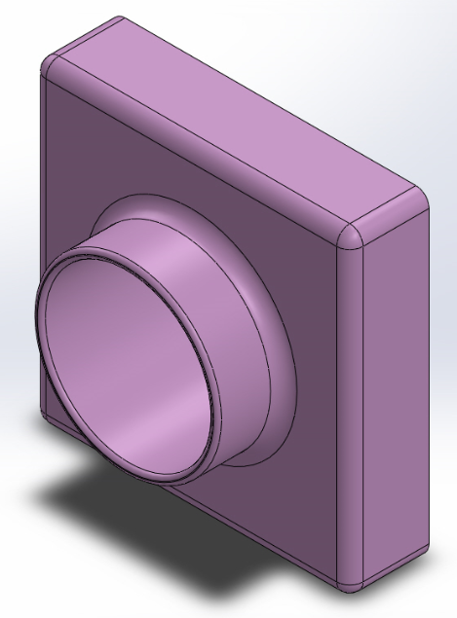
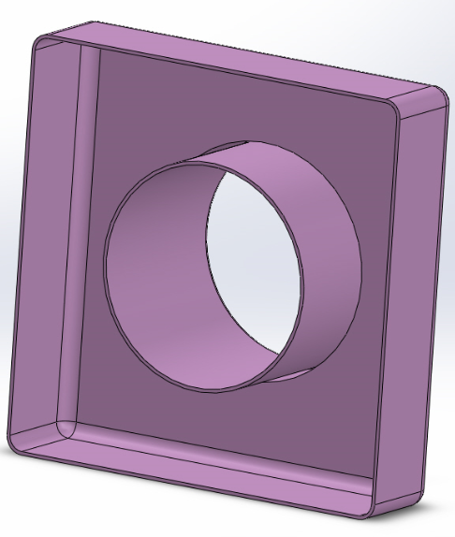
Work
Tutor 1
FRONT
Back

Slide 9
8-30: Second Day of Class

Slide 10
9-6
What we did:
Created Tutor 2
Created Tutor 2 and assembly of Tutor 1 and Tutor 2
Learned how to use the features:
Mate
Shell
Convert Entities
Offset Entities
Show and Remove Invisible Lines

Slide 11
Work
Follow the directions given in the video supplied by ivytechengineering.com
Create the first part: Tutor 2
Submit Part to Professor
Video Link: https://www.youtube.com/watch?v=au8Vdnw-XyU

Slide 12
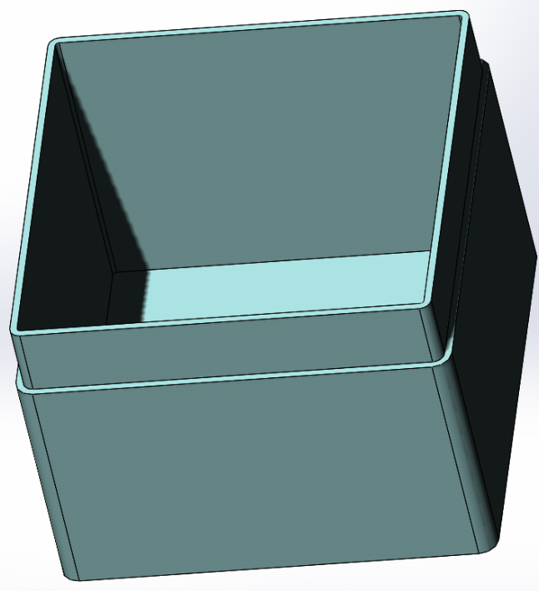
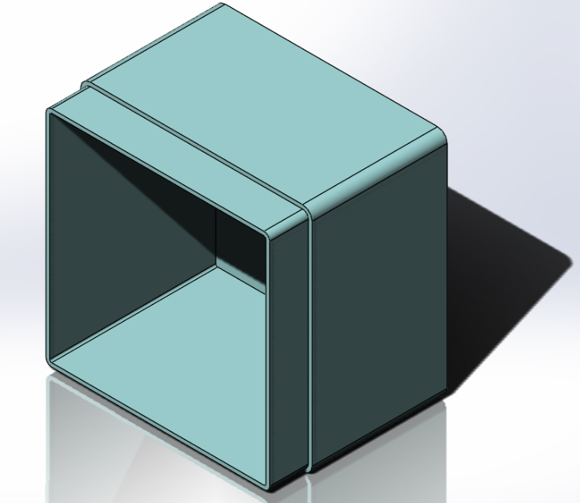
Work
Tutor 2

Slide 13
Work
Follow the directions given in the video supplied by ivytechengineering.com
Create the first assembly: Assembly 1
Submit Part to Professor
Video Link: https://www.youtube.com/watch?v=au8Vdnw-XyU

Slide 14
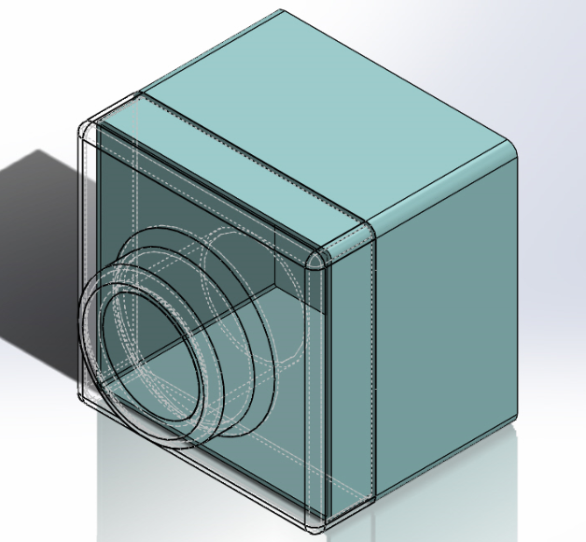
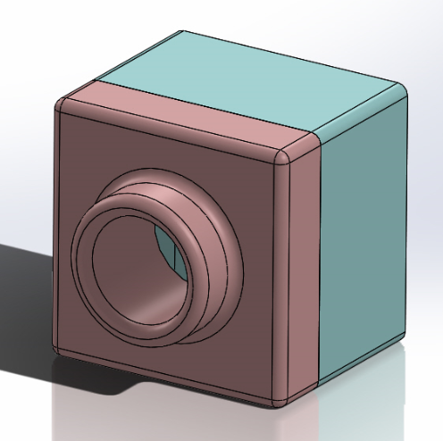
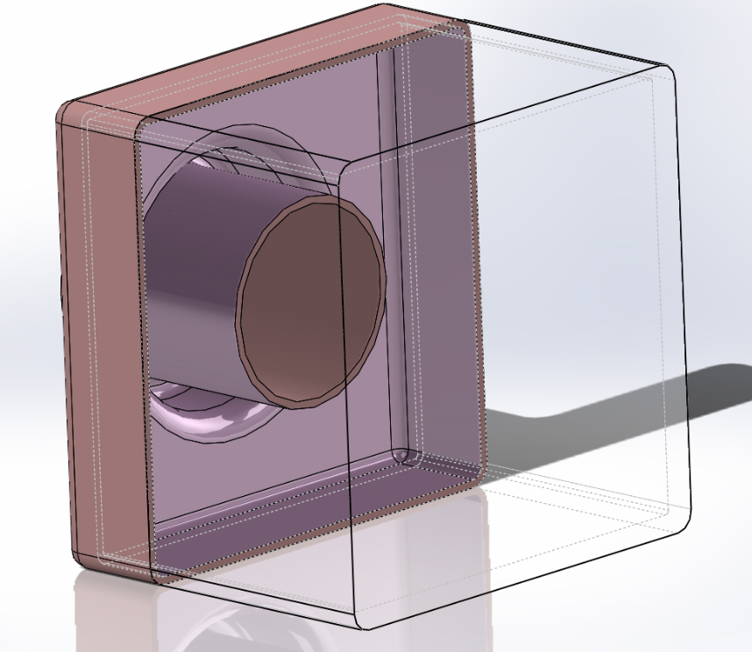
Work
Assembly 1

Slide 15
9-6: Third Day of Class

Slide 16
9-6
What we did:
Learned about the different views in solid works (i.e. Isometric, Diametric, Trimetric…)
Created a part from scratch, with only an image to go off of, no dimensions.
Learned how to change the plane of a part if drawn incorrectly.
Learned about Boolean Operations.
Intersection
Difference
Union

Slide 17
Work
Create the image from Lecture 4 Slide 9 from scratch
Name it Part 2-14
Come up with your own dimensions and ways of creating the object

Slide 18
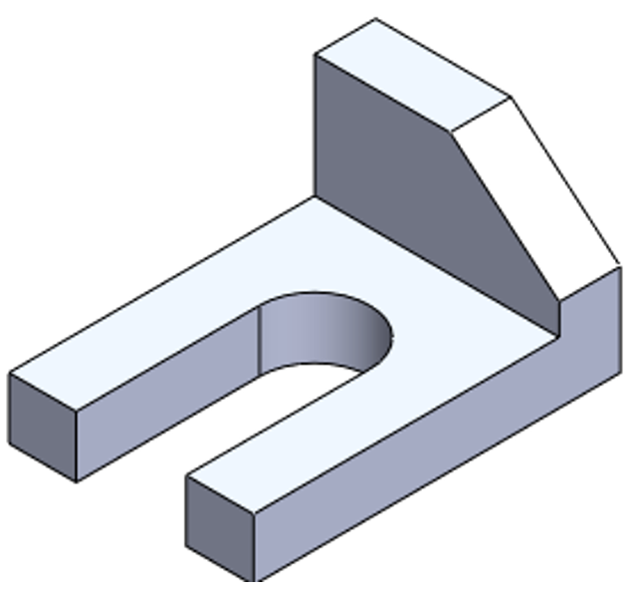
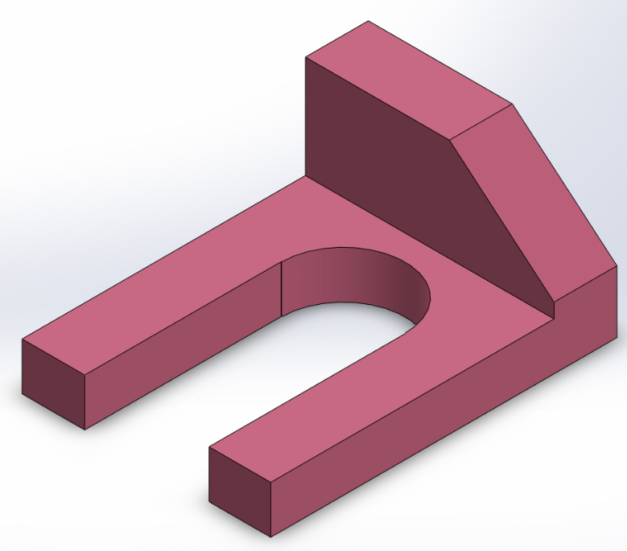
Work
From the Slide
My Interpretation

Slide 19
9-13: Fourth Day of Class

Slide 20
9-13
What we did:
Learned about drafting standards
ANSI
ISO
DIN
JIS
Learned about the two types of dimensioning systems:
U.S. (IPS)
Metric (MMGS)

Slide 21
Work
Imitate the drawing from Lecture 8 Slide 8
- Follow the dimensions given and learn how to utilize them.
- Name the drawing Part 8-8

Slide 22
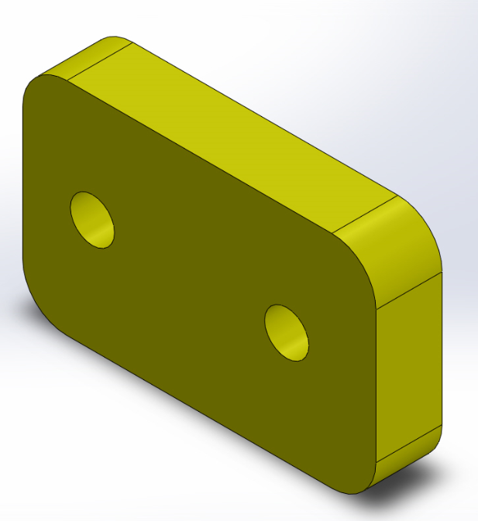
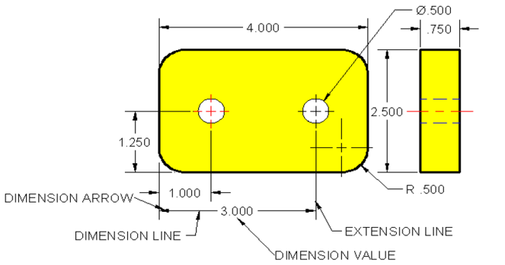
Work
From the Slide
My Interpretation

Slide 23
Work
Imitate the drawing from Lecture 8 Slide 11
- Follow the dimensions given and learn how to utilize them.
- Learn how to come up with dimensions not given.
- Name the drawing Part 8-11

Slide 24
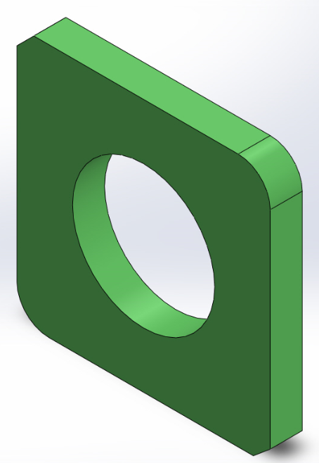
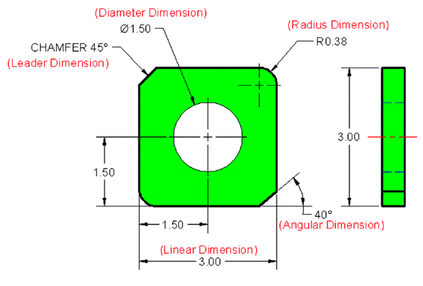
Work
From the Slide
My Interpretation

Slide 25
Work
Imitate the drawing from Lecture 8 Slide 15
- Follow the dimensions given and learn how to utilize them.
Name the drawing Part 8-15 Part 1 and Part 2
Learned how to:
Mirror

Slide 26
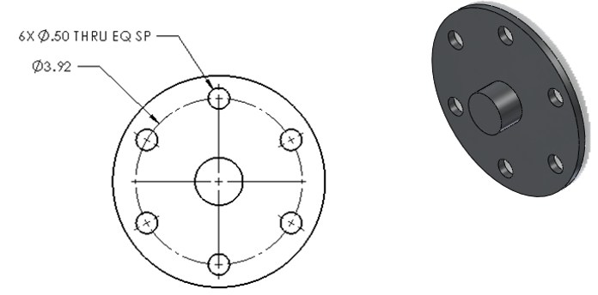
Work
Slide 15 Instruction

Slide 27
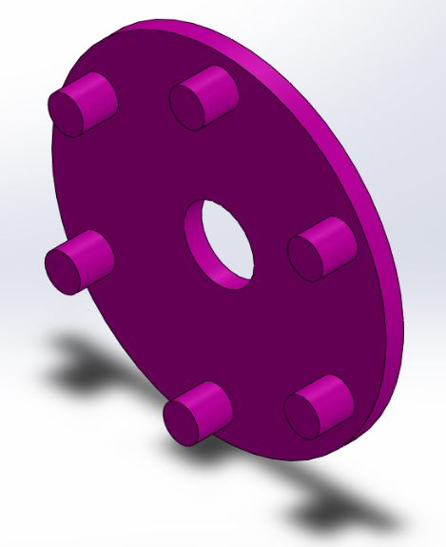
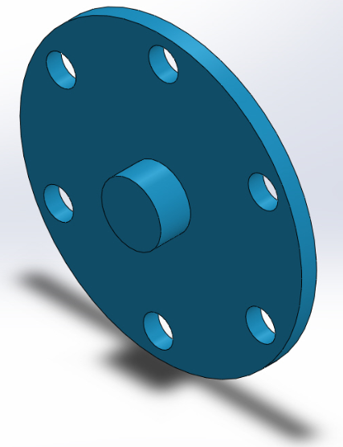
Work
Back
Front

Slide 28
Work
Now that both the front and back of Part 8-15 have been created Mate them
- Name this piece Assembly 8-15
Learned how to:
Mate

Slide 29
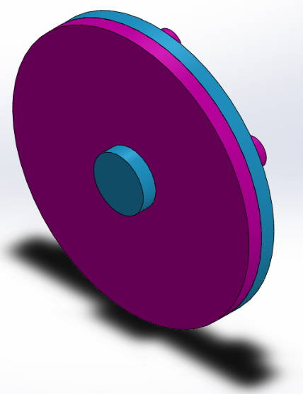
Work
Mated Piece

Slide 30
9-20: Fifth Day of Class

Slide 31
9-20
What we did:
Began work on Flashlight drawings
Designed Battery
Designed Battery Cap
Learned how to use relations when drawing objects with equal sides.

Slide 32
Work
Following the books guidelines create the battery
- Follow the dimensions given and learn how to utilize them.

Slide 33
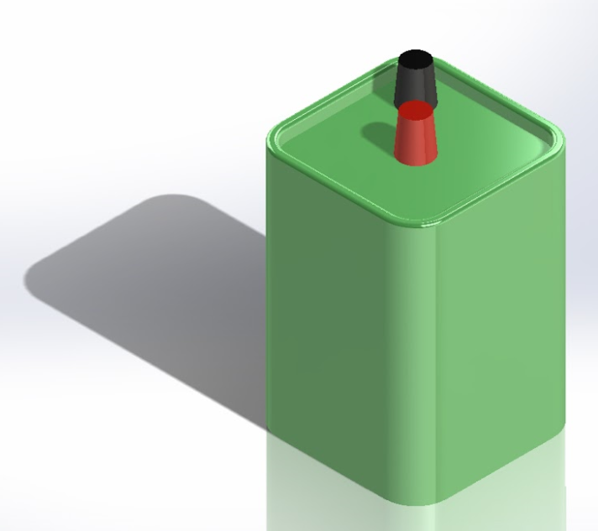
Work
This part was titled “Battery” and plays an integral role in the Flashlight project.
This part will later be used in an the entire assembly of said Flashlight at a later date.

Slide 34
Work
Following the books guidelines create the battery cap
- Follow the dimensions given and learn how to utilize them.

Slide 35
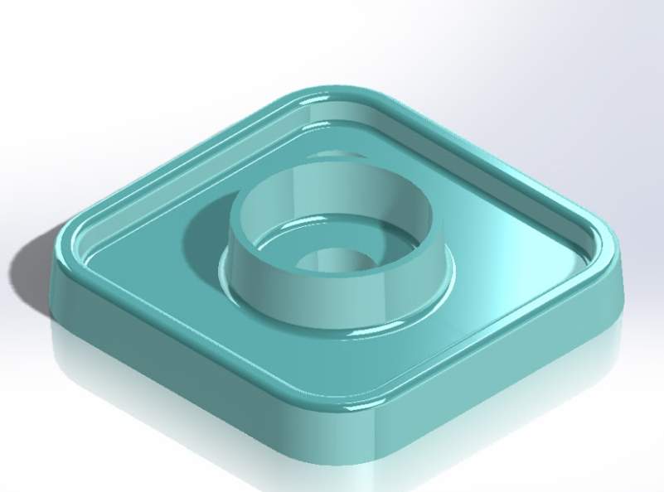
Work
This is the finished product for the part titled “Battery Cap”.
This was an inverse design of the part known as “Battery”.

Slide 36
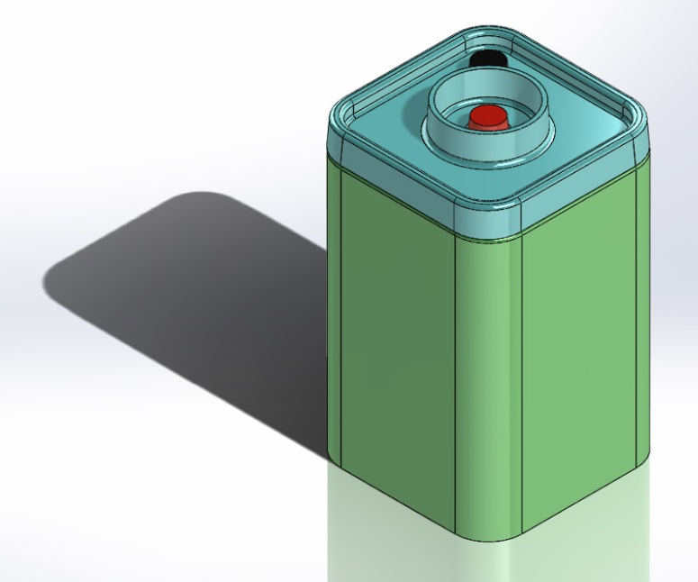
Work
This is a full assembly using the parts “Battery” and “Battery Cap”.
The assembly was done to ensure all parts fit properly together, if they did not adjustments would have to be made.
Fortunately, everything fit together the first time around.

Slide 37
9-27: sixth Day of Class

Slide 38
9-20
What we did:
Continued work on Flashlight drawings
Designed Lens
Designed Flashlight Bulb
Learned how to use revolved bases when drawing objects in a 3D form.

Slide 39
Work
Following the books guidelines create the Lens
- Follow the dimensions given and learn how to utilize them.

Slide 40
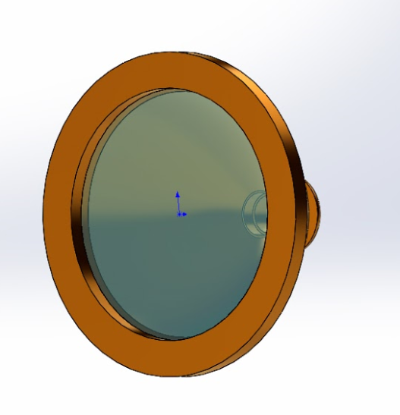
Work
The front of the “Lens” was made transparent so the part “Bulb” could later be seen though it.
This part will later be inserted in the front section of the assembly “Flashlight”.

Slide 41
Work
Following the books guidelines create the Bulb
- Follow the dimensions given and learn how to utilize them.

Slide 42
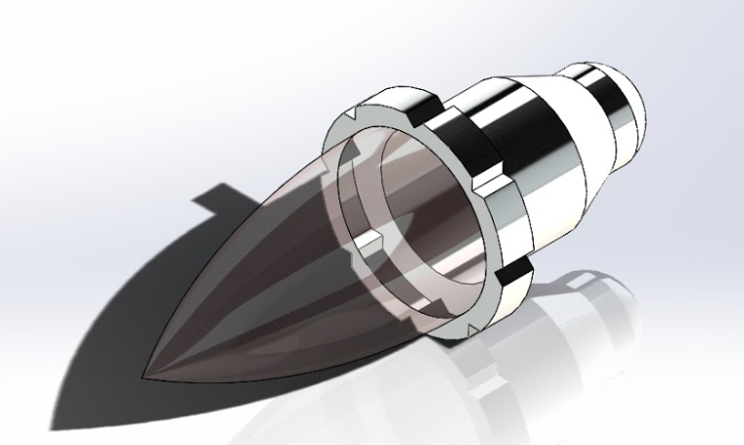
Work
The “Bulb” has been one of the more difficult pieces I have made thus far.
I believe this is because there are a lot of round features in it, which I a not normally accustom to using.
This pieces will later be mated with the above part “Lens”, and placed in the front portion of the Flashlight assembly.

Slide 43
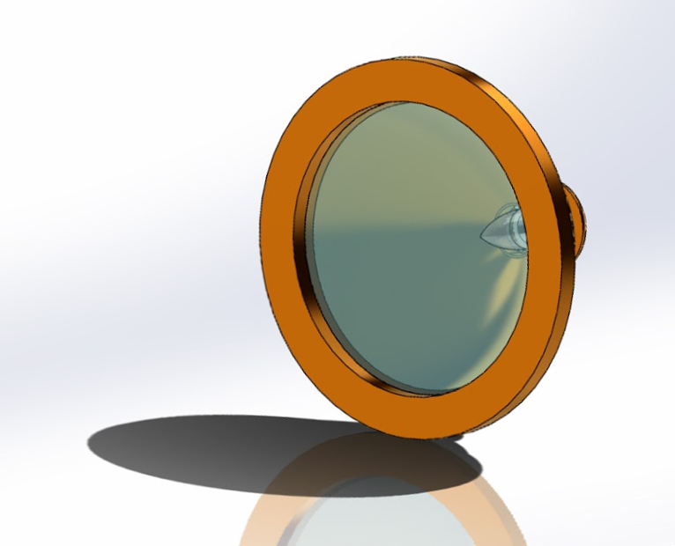
Work
This is the Assembly of the parts “Lens” and “Bulb”.
The Assembly is used as a sanity check to ensure all pieces align properly with one another.
There were no issues with this Assembly.

Slide 44
10-4: seventh Day of Class

Slide 45
10-4
What we did:
Continued work on Flashlight drawings
Designed “O” - Ring
Designed Lens Cap
Designed Flashlight Housing
Learned how to use ribbing, linear patterns and mirror properly.

Slide 46
Work
Following the books guidelines create the “O”-Ring
- Follow the dimensions given and learn how to utilize them.

Slide 47
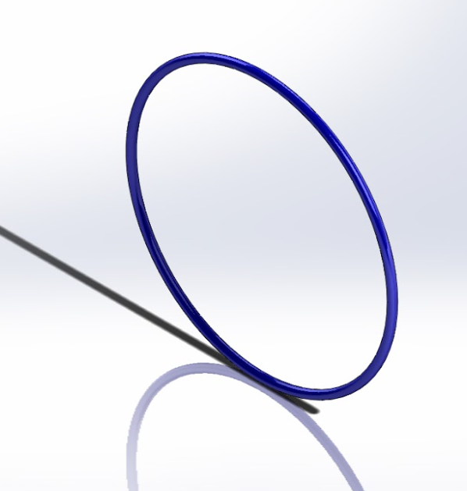
Work
The O-Ring was made by using the Swept Boss/Base function.
Although this piece was one of the more simpler items to create, it plays an important role in the final assembly of the Flashlight.

Slide 48
Work
Following the books guidelines create the Lens Cap
- Follow the dimensions given and learn how to utilize them.

Slide 49
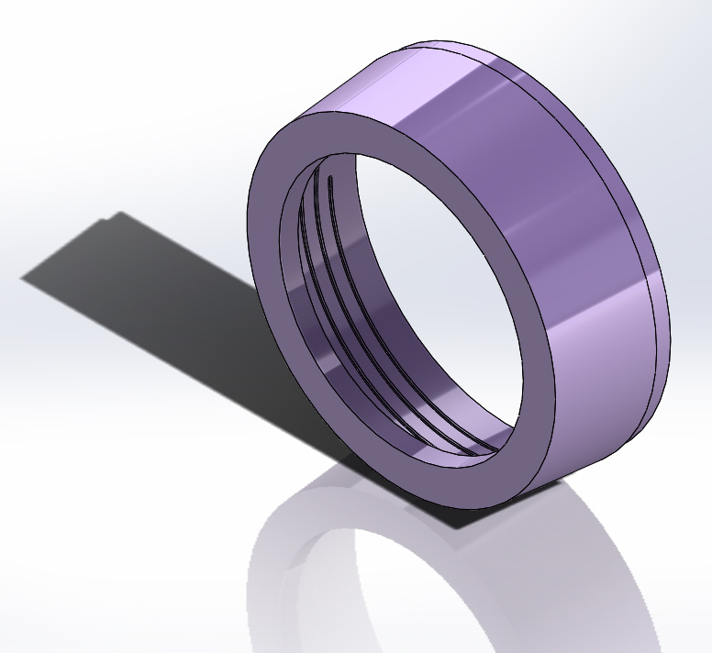
Work
The “Lens Cap” was designed using a helix. This was done so it later could be attached to the part “Housing”.
The purpose of the “Lens Cap”, is to hold the part “Lens” in place inside the “Housing”.

Slide 50
Work
Following the books guidelines create the Housing
- Follow the dimensions given and learn how to utilize them.

Slide 51
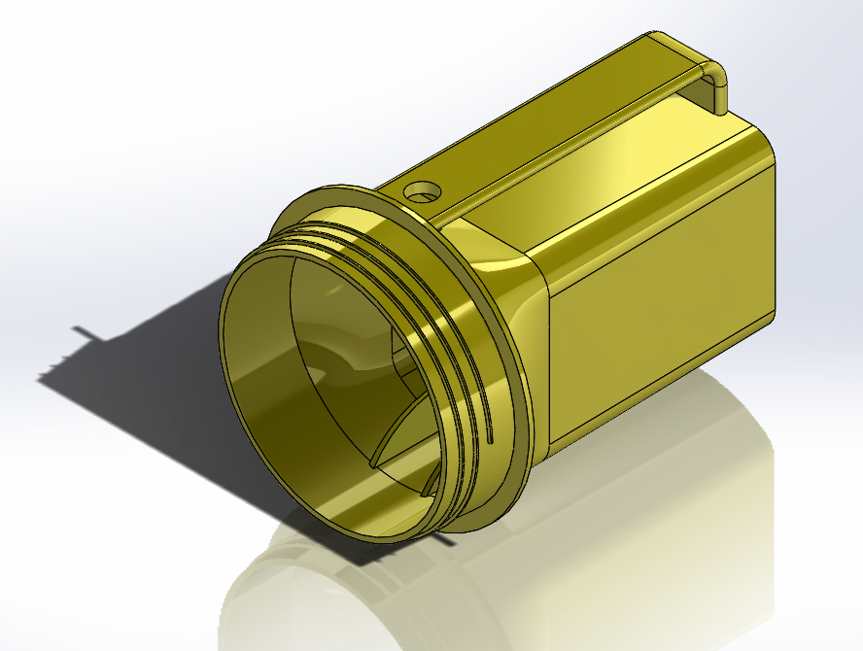
Work
The part to the right is titled “Housing” and will be the basis for the Flashlight project.
Every part will have to fit comfortably inside of this piece, so it is detrimental that all measurements are implemented correctly.

Slide 52
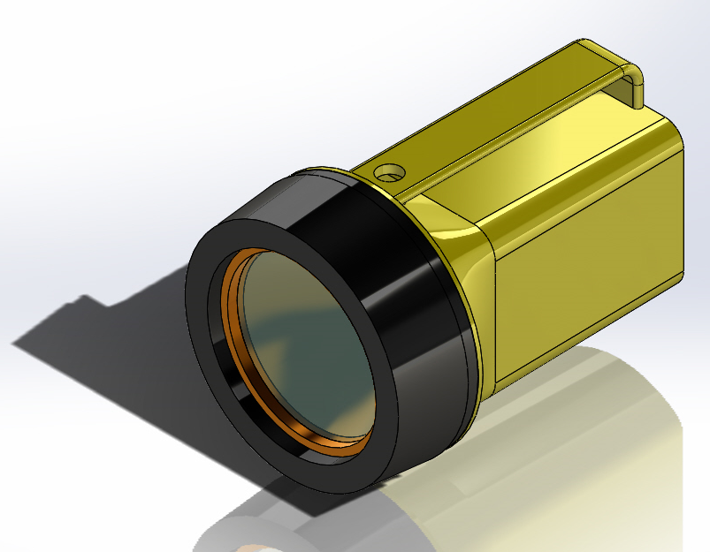
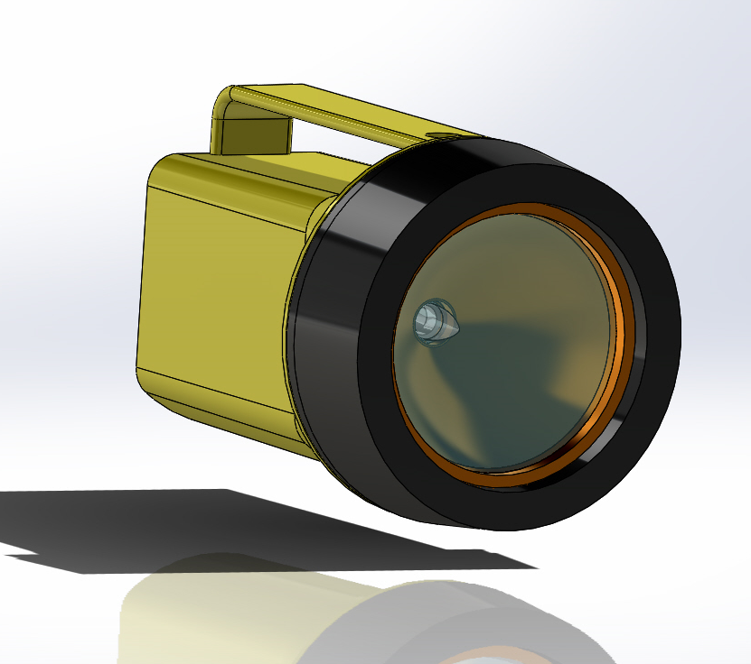
Work
This is an assembly of all parts created up to this point.
This assembly was done to assure all pieces fit properly with one another.
If they were not fitting appropriately measures would need to be taken to fix the issue.

Slide 53
10-11: Eighth Day of Class

Slide 54
10-11
What we did:
Got caught up to date:
Some of us still had some designs to work on
We took time to allow catch up

Slide 55
Work
Worked on homework assignments
Written
Solid Work Drawings

Slide 56
10-18: ninth Day of Class

Slide 57
10-18
What we did:
Got caught up to date:
Continued getting all work up to date
We took time to allow catch up

Slide 58
Work
Worked on homework assignments
Written
Solid Work Drawings
Pascal Bridge Drawings

Slide 59
Work
Following the books guidelines create the Switch
- Follow the dimensions given and learn how to utilize them.

Slide 60
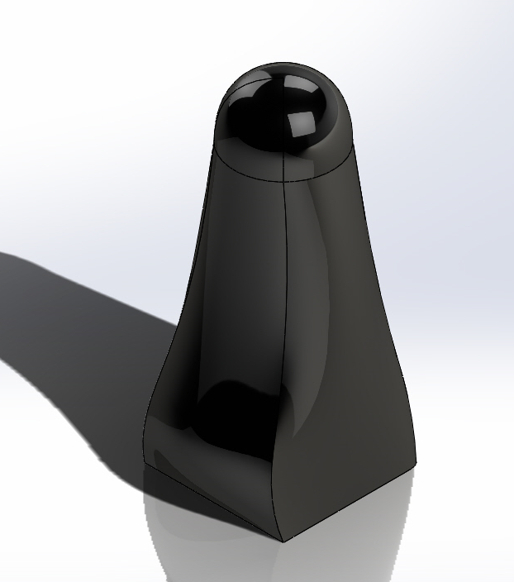
Work
The switch was created using many different features. This piece was one of the more complicated designs, the most complicated being the Housing part.

Slide 61
10-25: Tenth Day of Class

Slide 62
10-25
What we did:
Got caught up to date:
Finished work on Pasco Bridge Part

Slide 63
Work
Created a 3D Solid Works model from a Pasco Bridge part
- Measurements were taken using calipers
- The measurements were then translated into Solid Works
- Collaborated with fellow students who were making similar parts

Slide 64

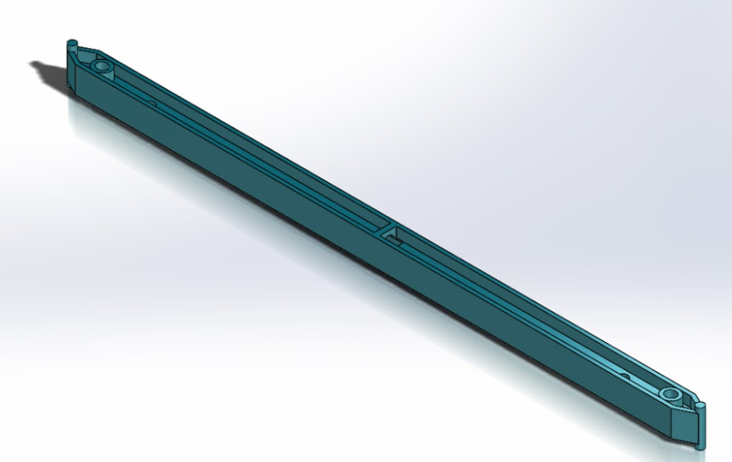
Work
Pasco Bridge Part # 5
Original Piece
Solid Works Model

Slide 65
11-1: Eleventh Day of Class

Slide 66
11- 1
What we did:
Pasco Bridge:
Began work on a second Pasco Bridge Part #17 (aka straight connector)
This piece had more curves and defined edges then my previously worked on piece.

Slide 67
Work
Created a 3D Solid Works model from a Pasco Bridge part
- Measurements were taken using calipers
- The measurements were then translated into Solid Works
- Collaborated with fellow students who were making similar parts

Slide 68
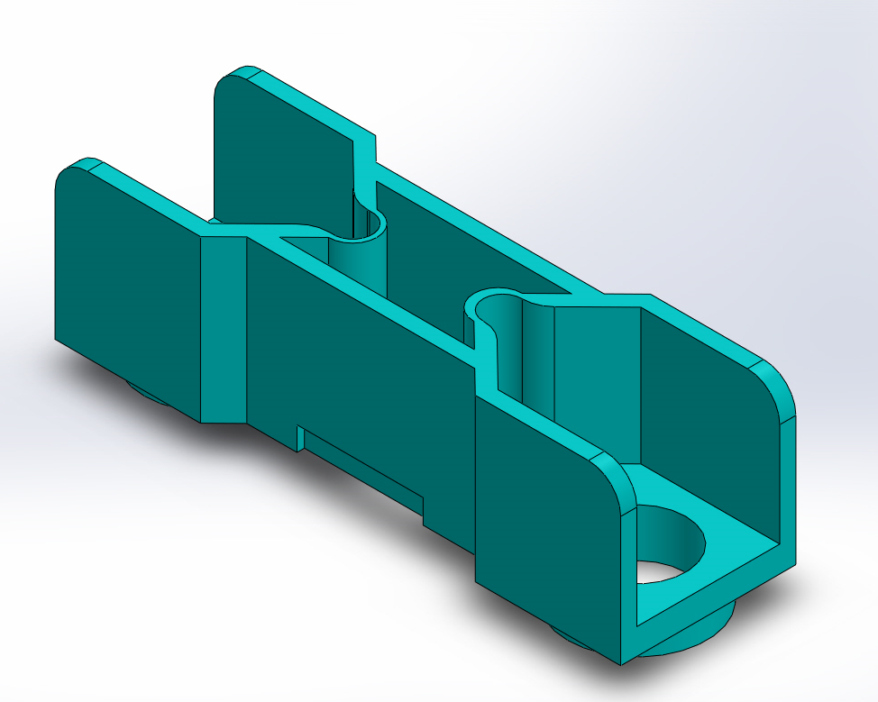
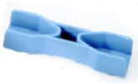
Work
Pasco Bridge Part #17
Original Piece
Solid Works Model

Slide 69
11-8: Twelfth Day of Class

Slide 70
11- 15
What we did:
Worked on rendering a frame for a ball launching robot
Measurements were taken
Measurements were translated into solid works

Slide 71
Work
The class worked together to create a design
- Measurements were taken using calipers
- The measurements were then translated into Solid Works
- Collaborated with fellow students who were making similar parts

Slide 72
11-15: Thirteenth Day of Class

Slide 73
11- 15
What we did:
Finished on the frame for a ball launching robot
Double checked measurements
Redefined mates

Slide 74
Work
The class worked together to create a design
- Measurements were taken using calipers
- The measurements were then translated into Solid Works
- Collaborated with fellow students who were making similar parts

Slide 75
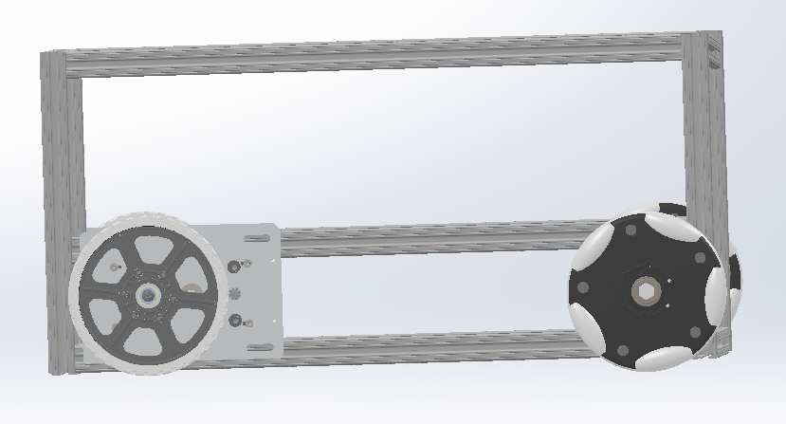
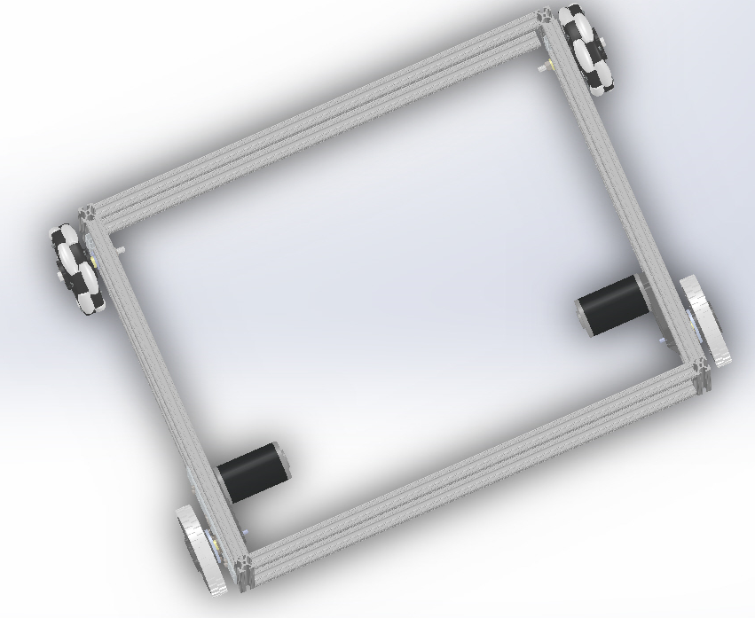
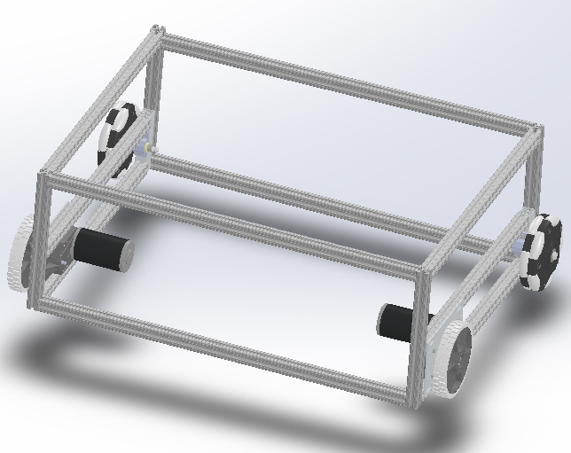
Work
Robot Frame Design

Slide 76
11-22: Break – no class

Slide 77
11-29: fifteenth Day of Class

Slide 78
10-29
What we did:
Got caught up to date:
Some of us still had some designs to work on
We took time to allow catch up

Slide 79
Work
Worked on homework assignments
- Updating lab Notebook
- Helped classmates with unfinished designs

Slide 80
12-6: Sixteenth Day of Class

Slide 81
12-6
What we did:
Modify Flashlight Model For Printing:
The lens cap needed to be made solid
Extend the handle of the flashlight
Remove ribbing from interior

Slide 82
Work
Why modify the flashlight?
- Because this flashlight is not going to be made on a production line, with multiple steps parts of the flashlight needed to be changed.
- Because of time constraints and the workability of a 3D printer, we had to make allowances.

Slide 83
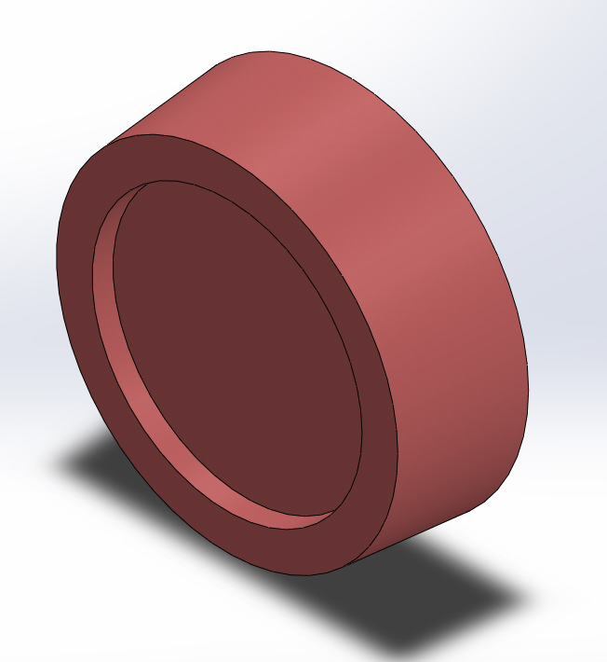
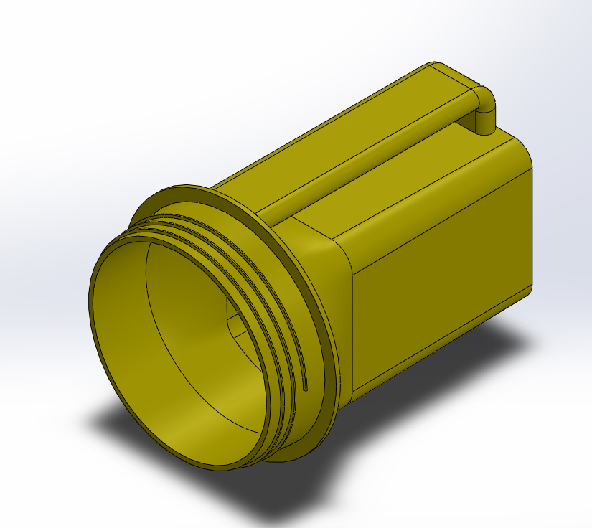
Work
Modified Flashlight

Slide 84
12-13: Seventeenth Day of Class

Slide 85
12-13
What we did:
Got caught up to date:
Some of us still had some designs to work on
We took time to allow catch up

Slide 86
Work
Worked on homework assignments
- Updating lab Notebook
- Helped classmates with unfinished designs

